Slide 1


Poinsettia Rooted Finished Trial Auburn University
Fall 2016

Slide 2
Poinsettia Rooted Finished Trial Auburn University Fall 2016
Objective: Determine performance of rooted poinsettias in HydraFiber vs. peat-lite substrates.
Initiated 8/17; Terminated 11/22
Commercial control; mixes ranging from 30% to 60% 160WB
Poinsettia ‘Christmas Day Red’
6” Standard pots
Clear water until 8/24; N at 150ppm w/15-3-16 +3 Ca 2 Mg; lowered to 100ppm N on 10/1
Pinched 9/7
Chemical treatments:
  Safari 1 tsp/gal / Capsil 2.5mL/gal (9/2)
  B-nine at 1250 ppm; Cycocel 800 ppm spray (9/19)

Slide 3
Media Treatments
Commercial Control (Peat/Perlite)
70% Peat: 30% HydraFiber 160WB
60% Peat: 40% HydraFiber 160WB
50% Peat: 50% HydraFiber 160WB
40% Peat: 60% HydraFiber 160WB
50% Peat: 50% HydraFiber 160WB + N*
40% Peat: 60% HydraFiber 160WB + N*
*Supplemental slowly available N added

Slide 4
Substrate pH

Slide 5
Substrate EC

Slide 6
Growth Index and Chlorophyll SPAD Measurements 49 DAP
abc
ab
a
abc
bc
c
bc
Least squares means comparisons among substrates using the Shaffer simulated method at α = 0.05. (NS for Growth Index)
Least squares means comparisons to the commercial mix using the Dunnett's method at α = 0.05 (*). (SPAD only)
Note: None of the HydraFiber mixes were different from the commercial mix based on Dunnett's test. (SPAD only)

Slide 7
Shoot Dry Weight 94 DAP
Least squares means comparisons among substrates using the Shaffer simulated method at α = 0.05. (NS for Shoot Dry Weight)

Slide 8
Foliar Tissue Analysis 63 DAP
 | (%) |  |  |  |  |  | (ppm)
Substrate | N | P | Mg | K | Ca | S | B | Fe | Mn | Cu | Zn | Al
Commercial mix | 3.44ns | 0.280ab | 0.349b | 2.60c | 0.715ab | 0.199ns | 16.95ab | 53.2ns | 28.1c | 0.725b | 19.7c | 13.1ns
30% HydraFiber | 3.62 | 0.262b | 0.434ab | 2.68bc | 0.568b | 0.205 | 14.63b | 53.7 | 39.0bc | 0.875ab | 21.4bc | 11.0
40% HydraFiber | 3.16 | 0.290ab | 0.447a | 2.95abc | 0.633ab | 0.202 | 15.85ab | 48.9 | 48.4ab | 0.900ab | 24.2abc | 10.0
50% HydraFiber | 3.89 | 0.276ab | 0.508a | 3.04ab | 0.758a | 0.220 | 17.93a | 58.7 | 58.5a | 1.100ab | 26.8ab | 12.1
60% HydraFiber | 3.79 | 0.308a | 0.478a | 3.15a | 0.750a | 0.214 | 18.23a | 57.6 | 66.0a | 1.275a | 27.1ab | 15.4
50% HydraFiber+N | 3.51 | 0.250b | 0.447a | 2.65bc | 0.688ab | 0.202 | 17.85a | 52.0 | 56.7ab | 0.850ab | 24.7abc | 9.7
60% HydraFiber+N | 3.51 | 0.244b | 0.453a | 2.69bc | 0.702ab | 0.215 | 17.80a | 55.7 | 55.4ab | 1.100ab | 29.5a | 12.9
Least squares means comparisons among substrates using the Shaffer simulated method at α = 0.05. ns=not significant.

Slide 9
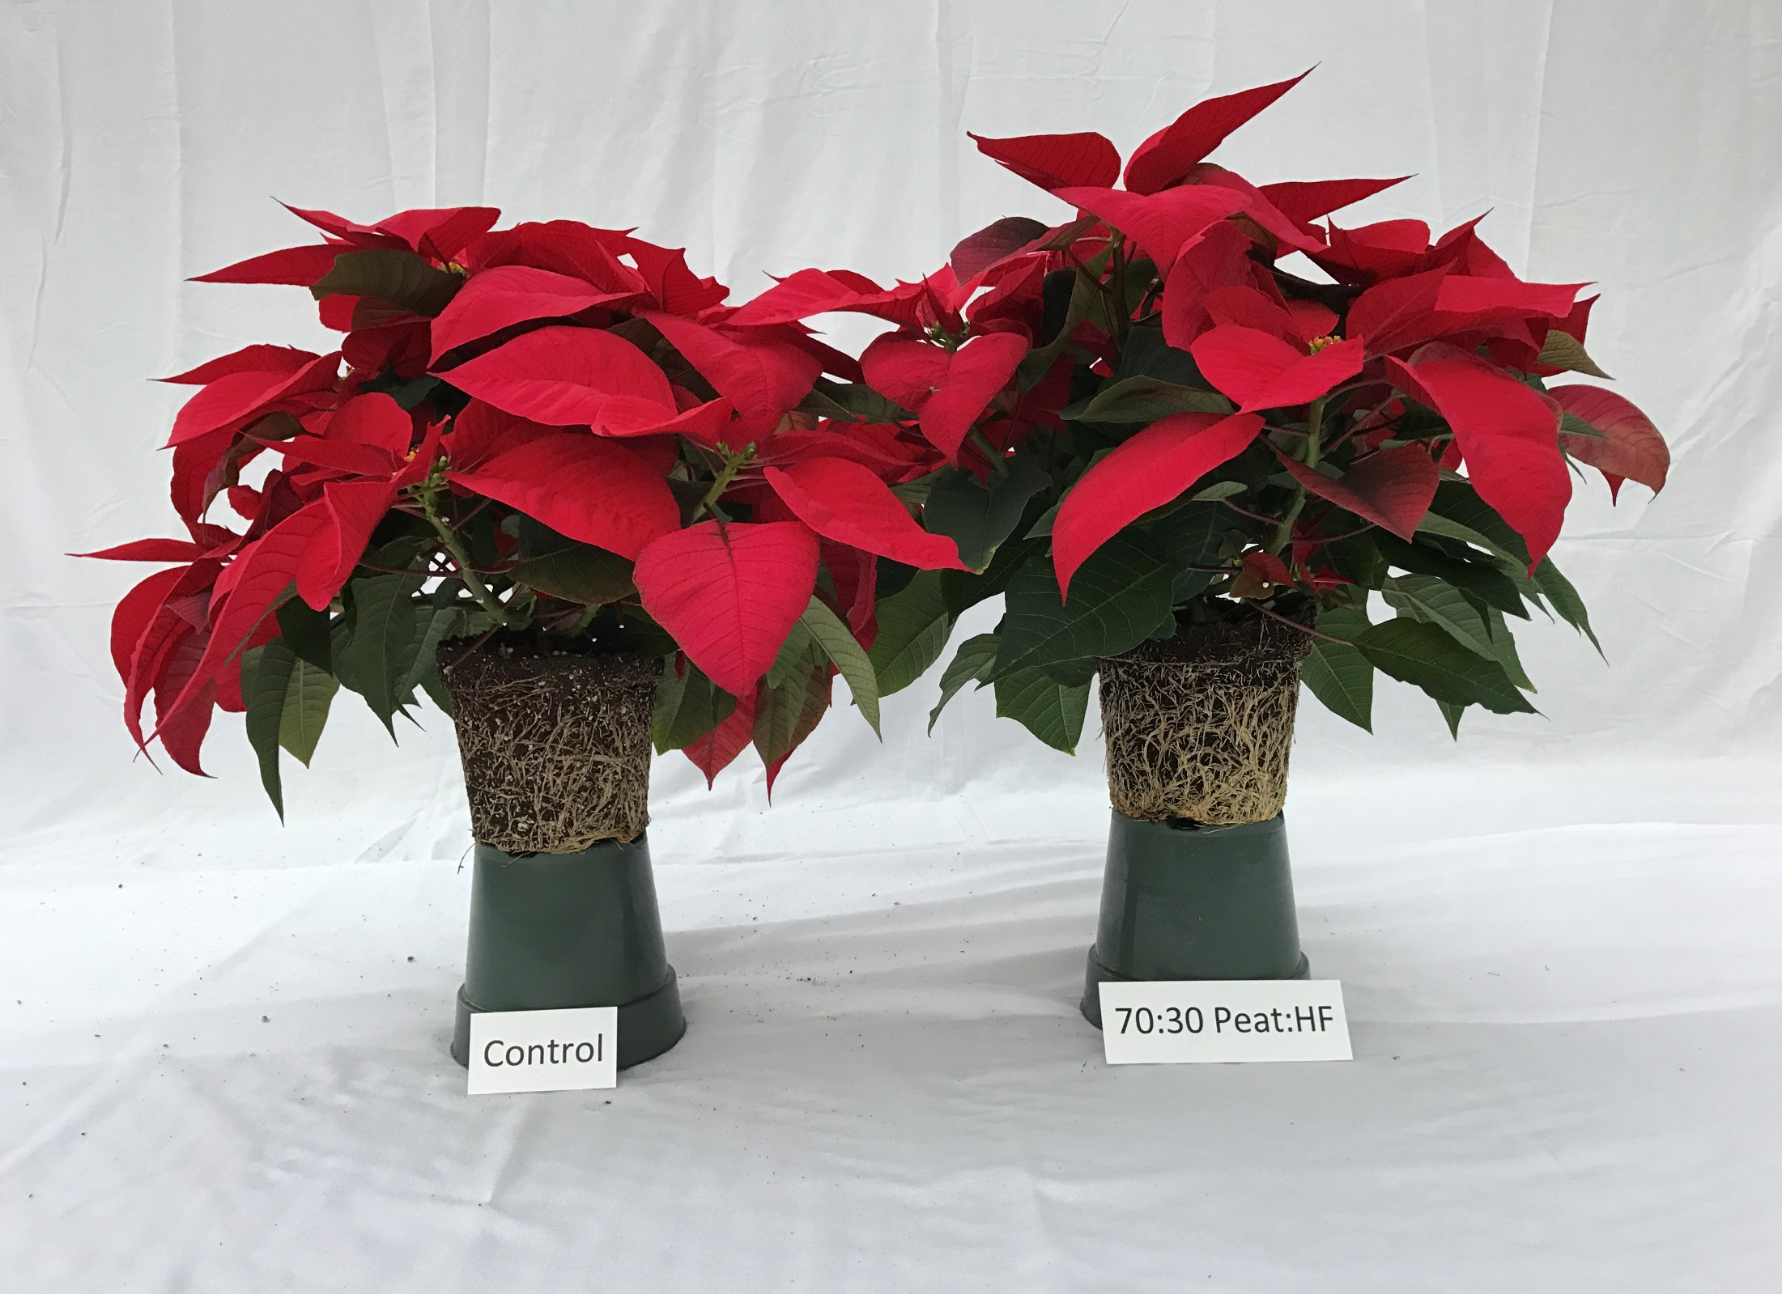
Control
70 Peat: 30 160WB
Dr. Glenn Fain
Auburn University

Slide 10
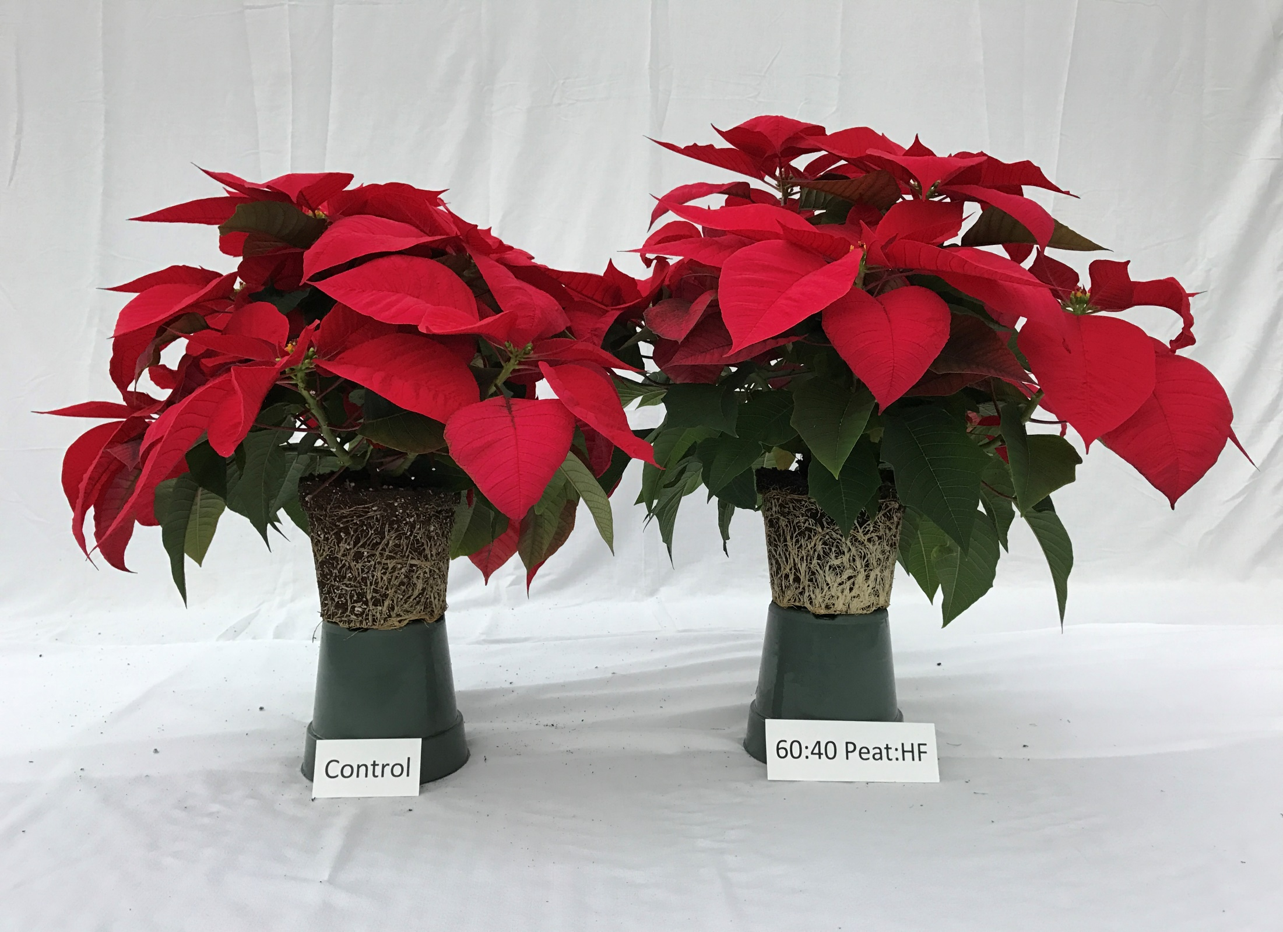
Control
60 Peat: 40 160WB
Dr. Glenn Fain
Auburn University

Slide 11
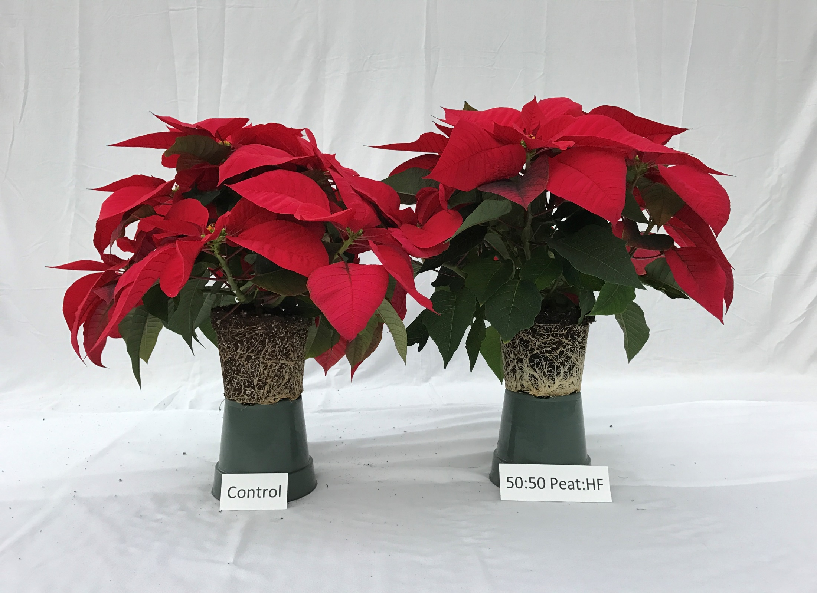
Control
50 Peat: 50 160WB
Dr. Glenn Fain
Auburn University

Slide 12
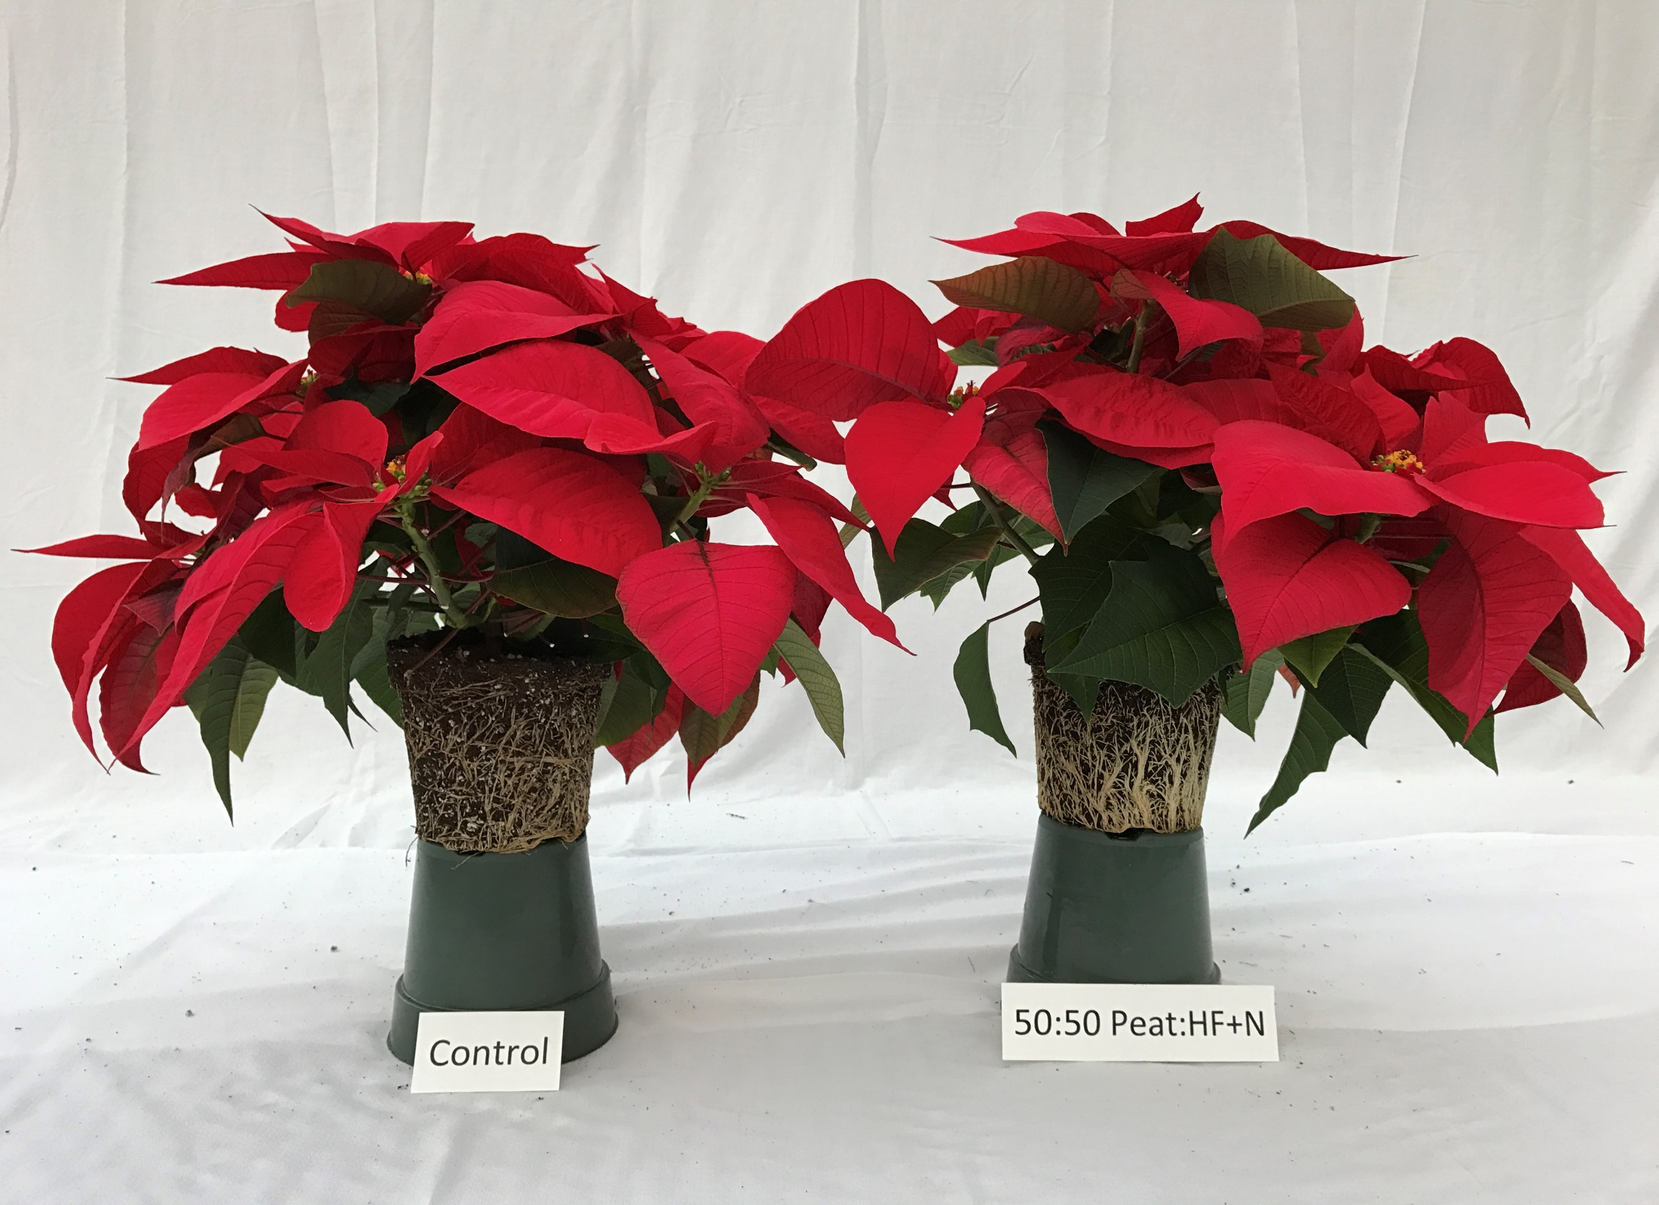
Control
50 Peat: 50 160WB + N
Dr. Glenn Fain
Auburn University

Slide 13
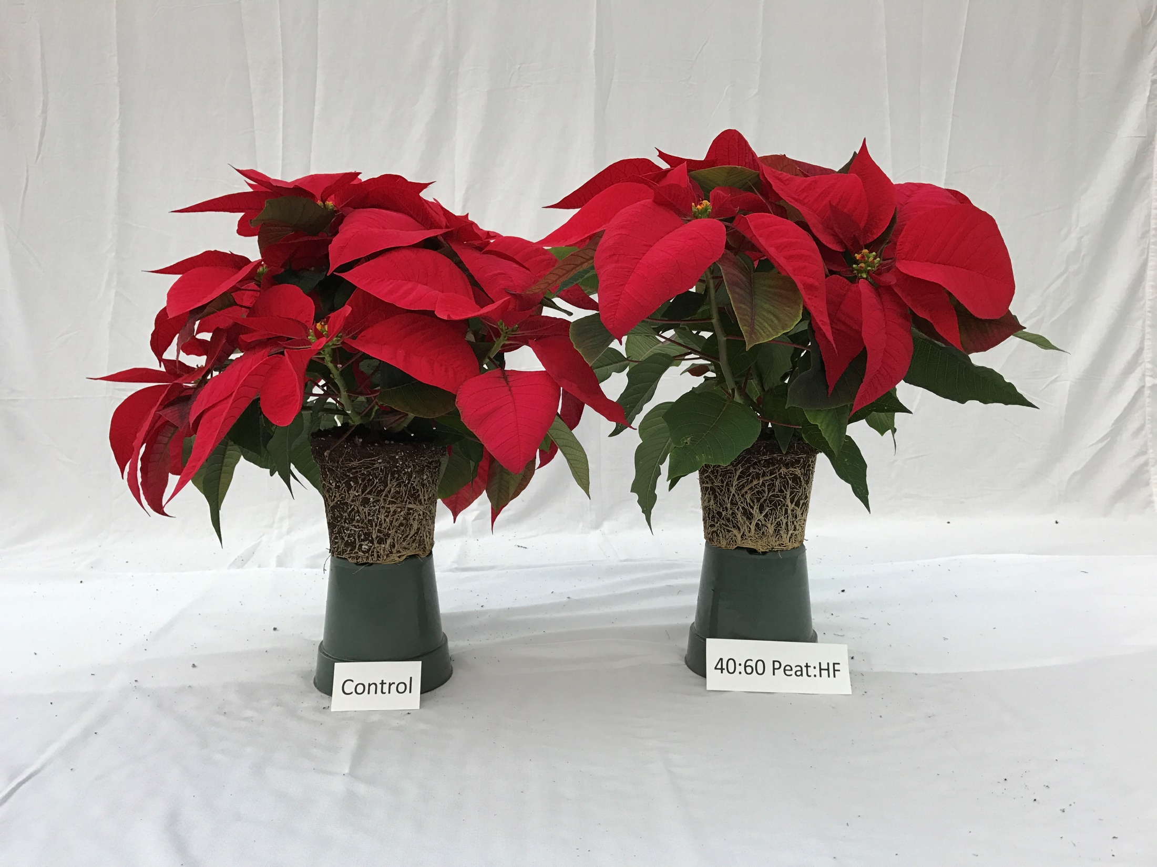
Control
40 Peat: 60 160WB
Dr. Glenn Fain
Auburn University

Slide 14
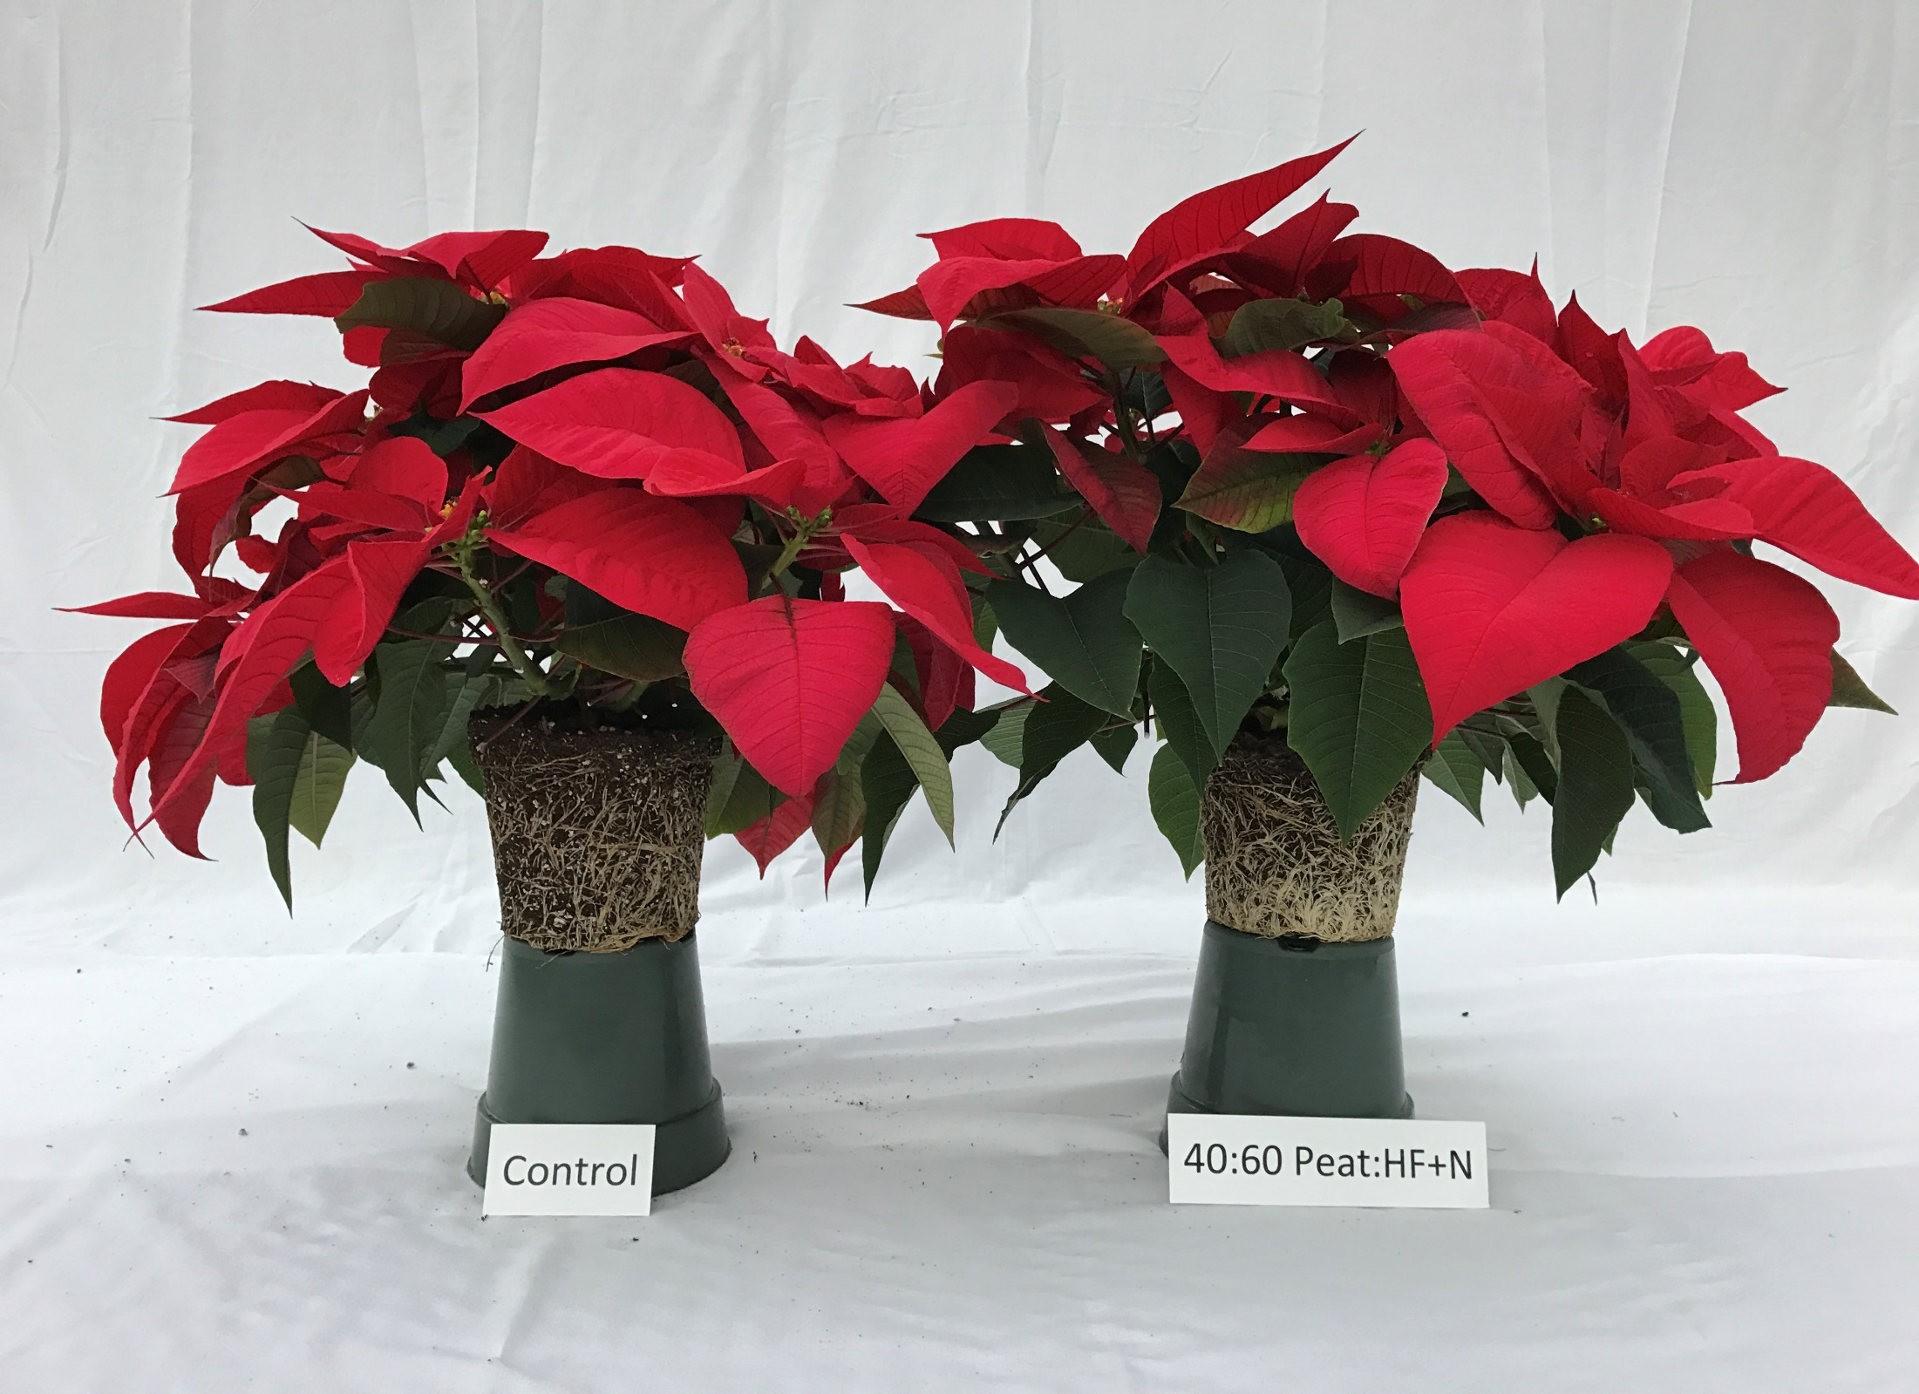
Control
40 Peat: 60 160WB + N
Dr. Glenn Fain
Auburn University

Slide 15
Conclusions
All tested treatments resulted in market-quality plants.
Can successfully grow poinsettias up to 60% HydraFiber.
Supplemental N did not provide commercially significant benefits at tested feed rate.
No statistical differences in plant growth (Shoot dry weight).
Despite some statistical differences in SPAD and foliar tissue measurements, differences did not manifest in visual quality differences.

